Slide 1
Introduction to AI
CT017-3-1 Ver 1.0
Computer Vision

Slide 2
Topic & Structure of the Lesson
What is Computer Vision?
How Does Computer Vision Work?
What are Computer Vision Applications?
What are the Challenges of Computer Vision?
Computer Vision Applications

Slide 3
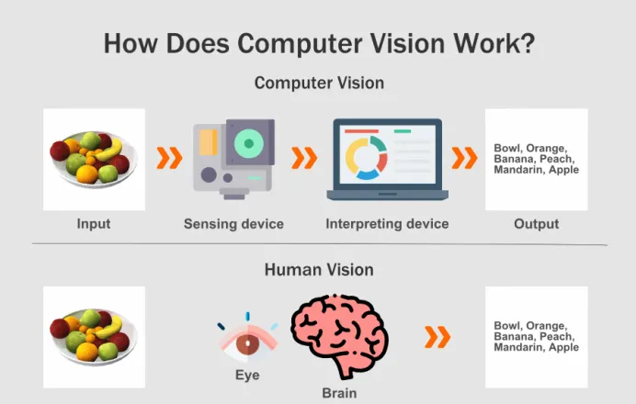

Slide 4
Computer Vision
Can analyses images and videos to produce the desired results in real time
Computer vision is a branch of artificial intelligence that enables computers to see and identify images, processing them as humans would.
Using images from cameras and videos, deep learning models enable machines to accurately identify and classify the objects.

Slide 5
How Does Computer Vision Work?
computer vision is a more high-level process. It deals with the analysis of an image.
the input is an image while the output is the interpretation of an image.
Computer vision works by identifying different components in the image.
What is Computer Vision?
https://www.youtube.com/watch?v=xXgnmKcnyTg How is it to work?
https://www.youtube.com/watch?v=OcycT1Jwsns&t=117s

Slide 6
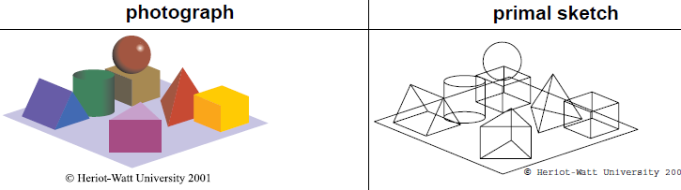
Essential – 5 stages
1. image acuquistion – digitization
2 .Signal Processing
3. edge detection
4. Object recognition (pattern matching)
5. Image understanding

Slide 8
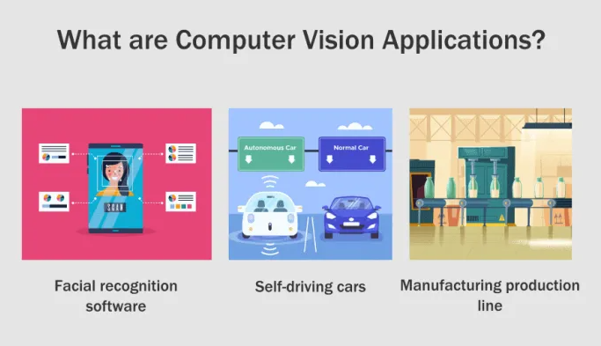
Components are then analysed.
A simple application sees computer vision identifying the edges in an image.
Computer vision enables pattern recognition or shapes to be identified.
More advanced applications allow for animals or people to be recognised.

Slide 9
What are Computer Vision Applications?
Applications of computer vision range from automation in self-driving vehicles to developing accurate
facial recognition software to inspecting bottles in a manufacturing production line to controlling robots, to organizing information for example indexing databases of images.
China using face recognition systems
https://www.youtube.com/watch?v=pNf4-d6fDoY
Next-Level Surveillance: China Embraces Facial Recognition
https://www.youtube.com/watch?v=Fq1SEqNT-7c

Slide 10
Other areas
Augmented and mixed reality technologies are increasingly being implemented in smartphones and tablets.
Additionally, smart glasses are also becoming more widely available.
All of this requires computer vision to help determine the location, detect objects and establish the depth or dimensions of the virtual world.

Slide 11
Why country using face recognition
China using face recognition systems
https://www.youtube.com/watch?v=pNf4-d6fDoY
Next-Level Surveillance: China Embraces Facial Recognition
https://www.youtube.com/watch?v=Fq1SEqNT-7c

Slide 12
How China use to fight corona?
Biggest country that uses face recognition system is china
https://www.youtube.com/watch?v=1MLGQL5pbbM&t=125s

Slide 13
Image Processing
Image processing transformations such as sharpening, smoothing , stretching and contrasting on an image
https://www.youtube.com/watch?v=9-8Js62wzQs&t=24s

Slide 14
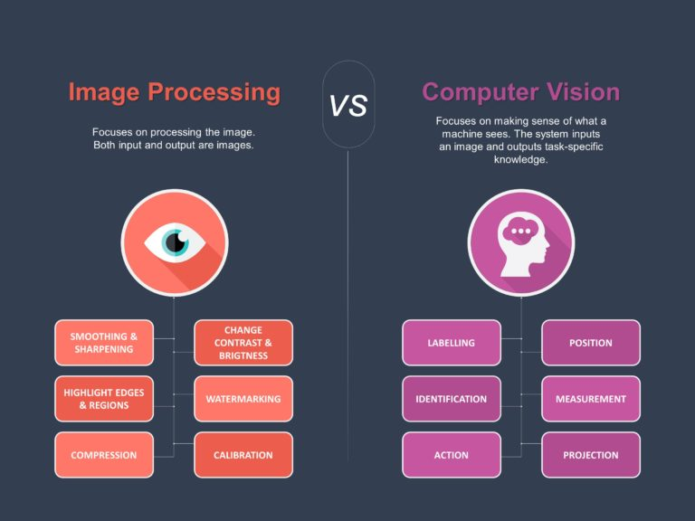

Slide 15
Is computer vision really AI?
ability to learn : YES - some systems are able to improve their recognition capability with time - the more "trees" they see examples of, the more likely they are to recognise another "tree" in the future;
use of language : NO
vision : obviously YES!
problem solving : NO - although the purpose of vision systems is to make it possible for computer systems to operate in problem-solving environments independently of humans;
adapting to new situations : YES - the ideal vision system would be able to cope with completely unfamiliar scenes, just as the human eye and brain can.

Slide 16
Tutorial
1)How is an image captured in vision system?
2)What features of vision system enable them to recognize image
3)How are artificial neural systems used with vision system?
4)What advantages do vision systems bring to the production line?
5)Describe a military use of vision systems
6)How are vision systems used with expert system in the analysis of satellite images?
7)How can vision systems combine with expert systems to help in the field of medicine

Slide 17
Question and Answer Session
Q & A

